Slide 1
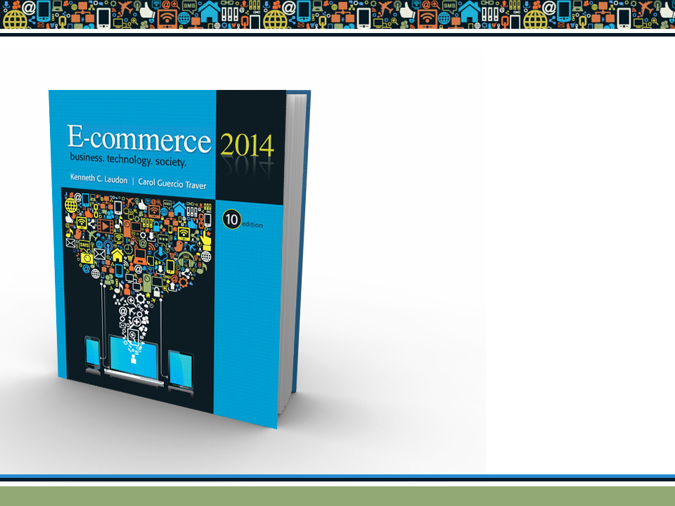
Copyright © 2014 Pearson Education, Inc. Publishing as Prentice Hall

Slide 2
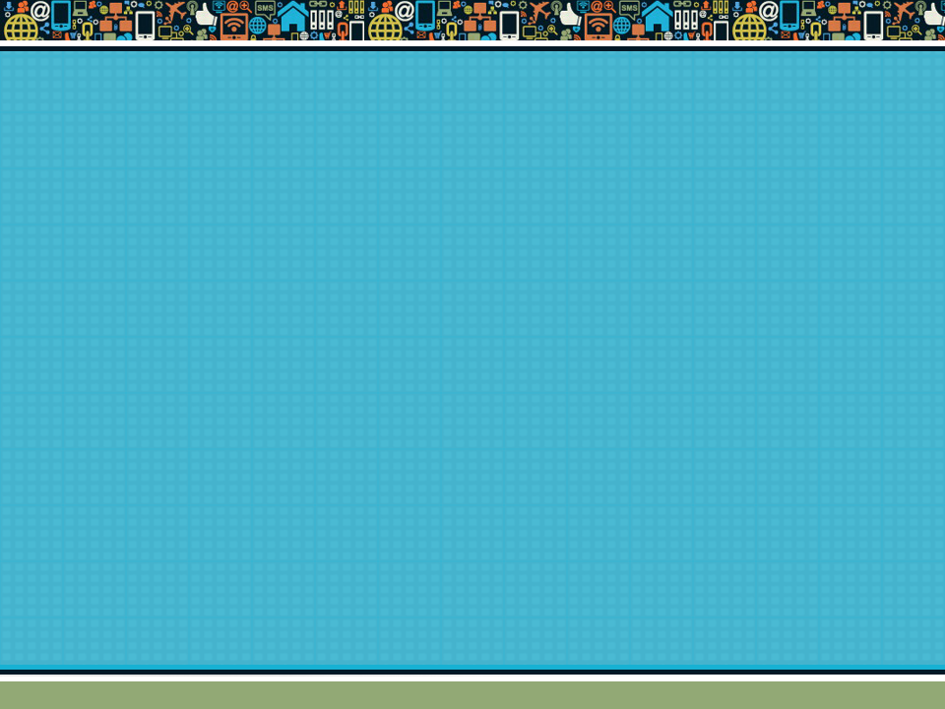
Chapter 5
E-commerce Security and
Payment Systems
Copyright © 2014 Pearson Education, Inc. Publishing as Prentice Hall

Slide 3
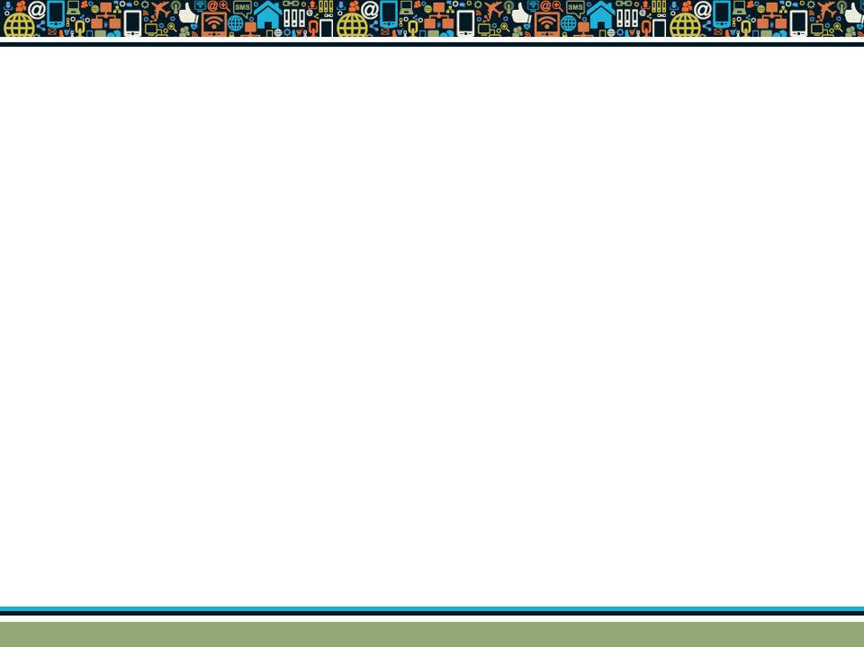
The E-commerce Security Environment
Overall size and losses of cyber crime unclear
  Reporting issues
2012 survey: Average annualized cost of cybercrime was $8.9 million/year
Underground economy marketplace:
  Stolen information stored on underground economy servers
Copyright © 2014 Pearson Education, Inc. Publishing as Prentice Hall
Slide 5-<number>

Slide 4
What Is Good E-commerce Security?
To achieve highest degree of security
  New technologies
  Organizational policies and procedures
  Industry standards and government laws
Other factors
  Time value of money
  Cost of security vs. potential loss
  Security often breaks at weakest link
Copyright © 2014 Pearson Education, Inc. Publishing as Prentice Hall
Slide 5-<number>

Slide 5
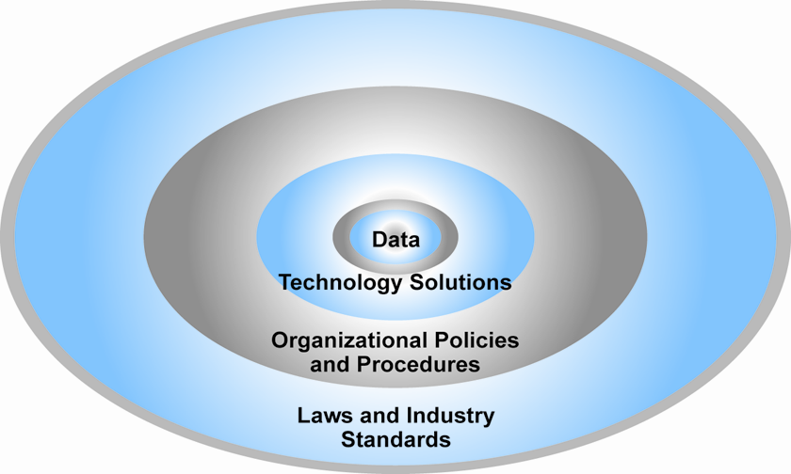
The E-commerce Security Environment
Figure 5.1, Page 252
Copyright © 2014 Pearson Education, Inc. Publishing as Prentice Hall
Slide 5-<number>

Slide 6
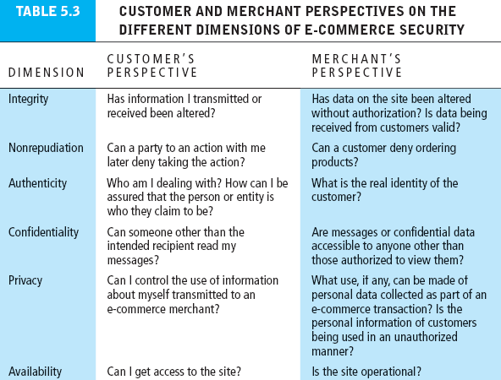
Table 5.3, Page 254
Copyright © 2014 Pearson Education, Inc. Publishing as Prentice Hall
Slide 5-<number>
Notes:
Integrity refers to the ability to ensure that information being displayed on a Website, or transmitted or received over the Internet, has not been altered in any way by an unauthorized party.
Nonrepudiation refers to the ability to ensure that e-commerce participants do not deny (i.e., repudiate) their online actions.
Authenticity refers to the ability to identify the identity of a person or entity with whom you are dealing on the Internet.
Confidentiality refers to the ability to ensure that messages and data are available only to those who are authorized to view them.
Availability refers to the ability to ensure that an e-commerce site continues to function as intended.

Slide 7
The Tension Between Security and
Other Values
Ease of use
  The more security measures added, the more difficult a site is to use, and the slower it becomes
Public safety and criminal uses of the Internet
  Use of technology by criminals to plan crimes or threaten nation-state
Copyright © 2014 Pearson Education, Inc. Publishing as Prentice Hall
Slide 5-<number>

Slide 8
Security Threats in the
E-commerce Environment
Three key points of vulnerability in e-commerce environment:
  Client
  Server
  Communications pipeline (Internet communications channels)
Copyright © 2014 Pearson Education, Inc. Publishing as Prentice Hall
Slide 5-<number>

Slide 9
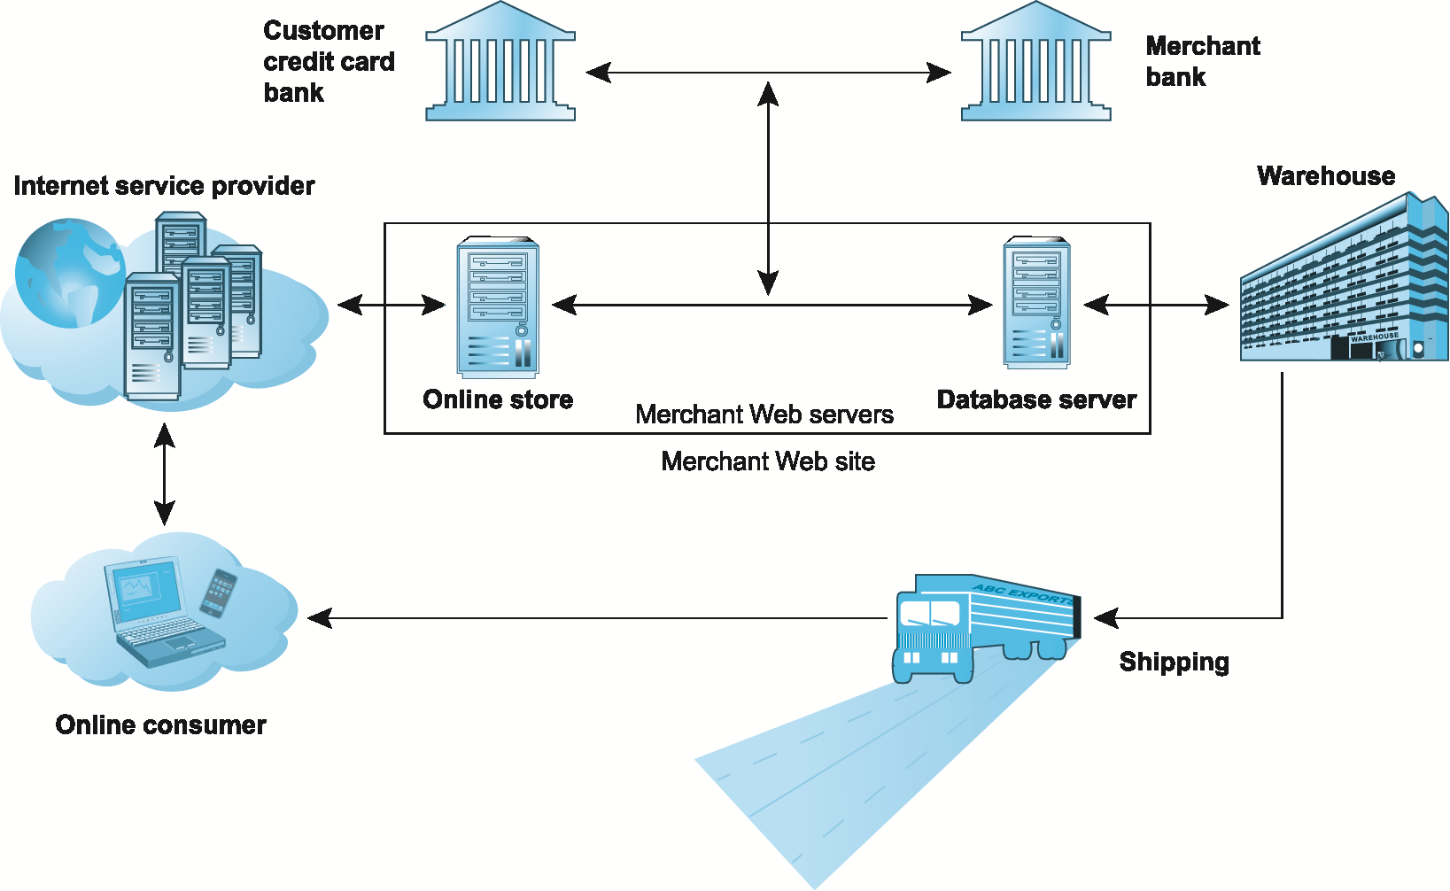
A Typical E-commerce Transaction
Figure 5.2, Page 256
Copyright © 2014 Pearson Education, Inc. Publishing as Prentice Hall
Slide 5-<number>

Slide 10
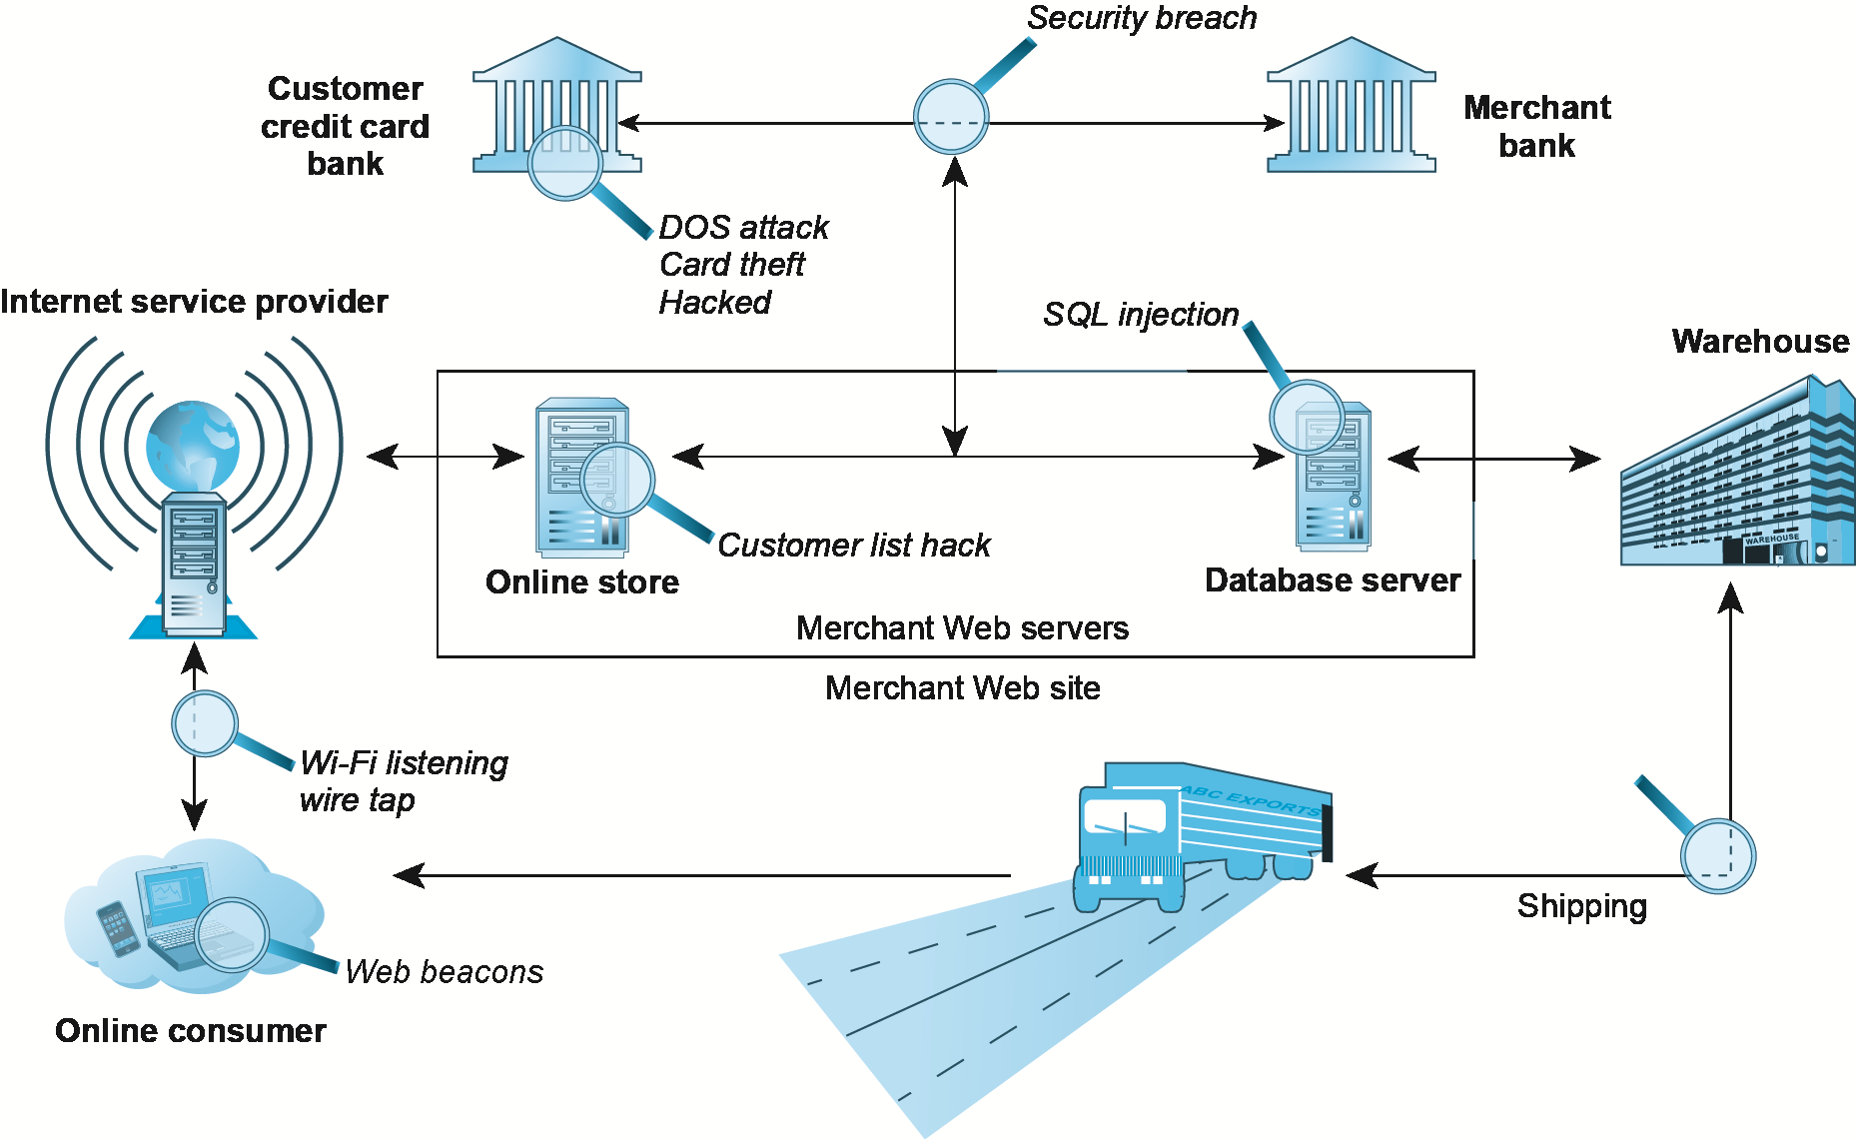
Vulnerable Points in an E-commerce Transaction
Figure 5.3, Page 257
Copyright © 2014 Pearson Education, Inc. Publishing as Prentice Hall
Slide 5-<number>

Slide 11
Most Common Security Threats in the
E-commerce Environment
Malicious code (malware, exploits)
  Drive-by downloads
  Viruses
  Worms
  Ransomware
  Trojan horses
  Backdoors
  Bots, botnets
  Threats at both client and server levels
Copyright © 2014 Pearson Education, Inc. Publishing as Prentice Hall
Slide 5-<number>
Notes:
A drive-by download is malware that comes with a downloaded file that a user intentionally or unintentionally requests.
A virus is a computer program that has the ability to replicate or make copies of
itself, and spread to other files.
a worm is designed to spread from computer to computer. A worm does not nec-
essarily need to be activated by a user or program in order for it to replicate itself.
Ransomware (scareware) is a type of malware (often a worm) that locks your
computer or files to stop you from accessing them. Ransomware will often display a notice that says an authority such as the FBI, Department of Justice, or IRS has
detected illegal activity on your computer and demands that you pay a fine in order to unlock the computer and avoid prosecution.
A Trojan horse appears to be benign, but then does something other than
expected. The Trojan horse is not itself a virus because it does not replicate, but is
often a way for viruses or other malicious code such as bots or rootkits
A backdoor is a feature of viruses, worms, and Trojans that allows an attacker to
remotely access a compromised computer.
Bots (short for robots) are a type of malicious code that can be covertly installed
on your computer when attached to the Internet.
Botnets are collections of captured computers used for malicious activities such as
sending spam, participating in a DDoS attack, stealing information from computers, and storing network traffic for later analysis.

Slide 12
Most Common Security Threats (cont.)
Potentially unwanted programs (PUPs)
  Browser parasites
  Adware
  Spyware
Phishing
  Social engineering
  E-mail scams
  Spear-phishing
  Identity fraud/theft
Copyright © 2014 Pearson Education, Inc. Publishing as Prentice Hall
Slide 5-<number>
Notes:
Spyware is a software that aims to gather information about a person or organization, sometimes without their knowledge, and send such information to another entity without the consumer's consent.
Unsolicited software that is installed in a computer without users realizing it. There are many different types. Parasites can report Web browsing habits to a marketing company over the Internet (see spyware) or change browser settings to point to a specific site.
Social engineering is the art of manipulating people so they give up confidential information. The types of information these criminals are seeking can vary, but when individuals are targeted the criminals are usually trying to trick you into giving them your passwords or bank information, or access your computer to secretly install malicious software–that will give them access to your passwords and bank information as well as giving them control over your computer.
Spear- phishing: the fraudulent practice of sending emails ostensibly from a known or trusted sender in order to induce targeted individuals to reveal confidential information.

Slide 13
Most Common Security Threats (cont.)
Hacking
  Hackers vs. crackers
  Types of hackers: White, black, grey hats
  Hacktivism
Cybervandalism:
  Disrupting, defacing, destroying Web site
Data breach
  Losing control over corporate information to outsiders
Copyright © 2014 Pearson Education, Inc. Publishing as Prentice Hall
Slide 5-<number>
Notes:
A hacker is an individual who intends to gain unauthorized access to a computer
System.
cracker is typically used to denote a hacker with criminal intent, although in the public press, the terms hacker and cracker tend to be used interchangeably.
Hacktivists typically attack governments, organizations, and even individuals for political purposes, employing the tactics of cyber-vandalism, distributed denial of service attacks, data thefts, doxing (gathering and exposing personal information of public figures, originating from the term “documents” or “docx”), and more.
These “good hackers” became known as white hats because of their role
in helping organizations locate and fix security flaws.
black hats are hackers who engage in the same kinds of activities
but without pay or any buy-in from the targeted organization, and with the intention of causing harm.
grey hats, hackers who believe they are pursuing some greater good by breaking in and revealing system flaws. Grey hats discover weaknesses in a system’s security, and then publish the weakness without disrupting the site or attempting to profit from their finds.

Slide 14
Most Common Security Threats (cont.)
Credit card fraud/theft
Spoofing and pharming
Spam (junk) Web sites (link farms)
Identity fraud/theft
Denial of service (DoS) attack
  Hackers flood site with useless traffic to overwhelm network
Distributed denial of service (DDoS) attack
Copyright © 2014 Pearson Education, Inc. Publishing as Prentice Hall
Slide 5-<number>
Notes:
A Distributed Denial of Service (DDoS) attack uses hundreds or even thou-
sands of computers to attack the target network from numerous launch points. DoS and DDoS attacks are threats to a system’s operation because they can shut it down indefinitely.

Slide 15
Most Common Security Threats (cont.)
Sniffing
  Eavesdropping program that monitors information traveling over a network
Insider attacks
Poorly designed server and client software
Social network security issues
Mobile platform security issues
  Vishing, smishing, madware
Cloud security issues
Copyright © 2014 Pearson Education, Inc. Publishing as Prentice Hall
Slide 5-<number>
Notes:
A sniffer is a type of eavesdropping program that monitors information traveling over
a network.

Slide 16
Technology Solutions
Protecting Internet communications
  Encryption
Securing channels of communication
  SSL, VPNs
Protecting networks
  Firewalls
Protecting servers and clients
Copyright © 2014 Pearson Education, Inc. Publishing as Prentice Hall
Slide 5-<number>

Slide 17
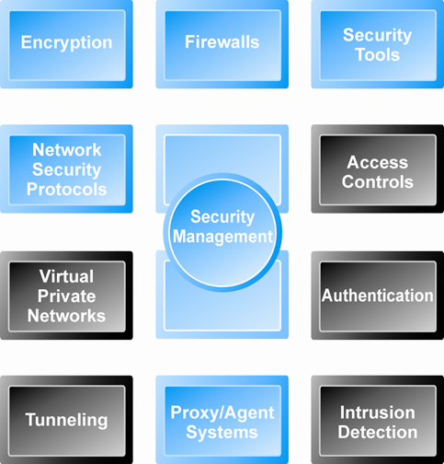
Tools Available to Achieve Site Security
Figure 5.5, Page 276
Copyright © 2014 Pearson Education, Inc. Publishing as Prentice Hall
Slide 5-<number>

Slide 18
Encryption
Encryption
  Transforms data into cipher text readable only by sender and receiver
  Secures stored information and information transmission
  Provides 4 of 6 key dimensions of e-commerce security:
    Message integrity
    Nonrepudiation
    Authentication
    Confidentiality
Copyright © 2014 Pearson Education, Inc. Publishing as Prentice Hall
Slide 5-<number>
Notes:
• Message integrity—provides assurance that the message has not been altered.
• Nonrepudiation—prevents the user from denying he or she sent the message.
• Authentication—provides verification of the identity of the person (or computer)
sending the message.
• Confidentiality—gives assurance that the message was not read by others

Slide 19
Symmetric Key Encryption
Sender and receiver use same digital key to encrypt and decrypt message
Requires different set of keys for each transaction
Strength of encryption
  Length of binary key used to encrypt data
Data Encryption Standard (DES)
Advanced Encryption Standard (AES)
  Most widely used symmetric key encryption
  Uses 128-, 192-, and 256-bit encryption keys
Other standards use keys with up to 2,048 bits
Copyright © 2014 Pearson Education, Inc. Publishing as Prentice Hall
Slide 5-<number>

Slide 20
Public Key Encryption
Uses two mathematically related digital keys
  Public key (widely disseminated)
  Private key (kept secret by owner)
Both keys used to encrypt and decrypt message
Once key used to encrypt message, same key cannot be used to decrypt message
Sender uses recipient’s public key to encrypt message; recipient uses private key to decrypt it
Copyright © 2014 Pearson Education, Inc. Publishing as Prentice Hall
Slide 5-<number>

Slide 21
Digital Envelopes
Uses symmetric key encryption to encrypt document
Uses public key encryption to encrypt and send symmetric key
Copyright © 2014 Pearson Education, Inc. Publishing as Prentice Hall
Slide 5-<number>
Notes:
s.

Slide 22
Digital Certificates and
Public Key Infrastructure (PKI)
Digital certificate includes:
  Name of subject/company
  Subject’s public key
  Digital certificate serial number
  Expiration date, issuance date
  Digital signature of CA
Public Key Infrastructure (PKI):
  CAs and digital certificate procedures
  PGP
Copyright © 2014 Pearson Education, Inc. Publishing as Prentice Hall
Slide 5-<number>
Notes:
a digital document issued by a certification authority that contains the name of the subject or company, the subject’s public key, a digital certificate serial number, an expiration date,
an issuance date, the digital signature of the certification authority, and other identifying information.
Public
key infrastructure (PKI) refers to the CAs and digital certificate procedures that are accepted by all parties. When you sign into a “secure” site, the URL will begin with “https” and a closed lock icon will appear on your browser. This means the site has a
digital certificate issued by a trusted CA. It is not, presumably, a spoof site.

Slide 23
Securing Channels of Communication
Secure Sockets Layer (SSL)/Transport Layer Security (TLS)
  Establishes secure, negotiated client–server session
Virtual Private Network (VPN)
  Allows remote users to securely access internal network via the Internet
Wireless (Wi-Fi) networks
  WPA2
Copyright © 2014 Pearson Education, Inc. Publishing as Prentice Hall
Slide 5-<number>

Slide 24
Protecting Networks
Firewall
  Hardware or software
  Uses security policy to filter packets
  Two main methods:
    Packet filters
    Application gateways
Proxy servers (proxies)
  Software servers that handle all communications from or sent to the Internet
Intrusion detection systems
Intrusion prevention systems
Copyright © 2014 Pearson Education, Inc. Publishing as Prentice Hall
Slide 5-<number>

Slide 25
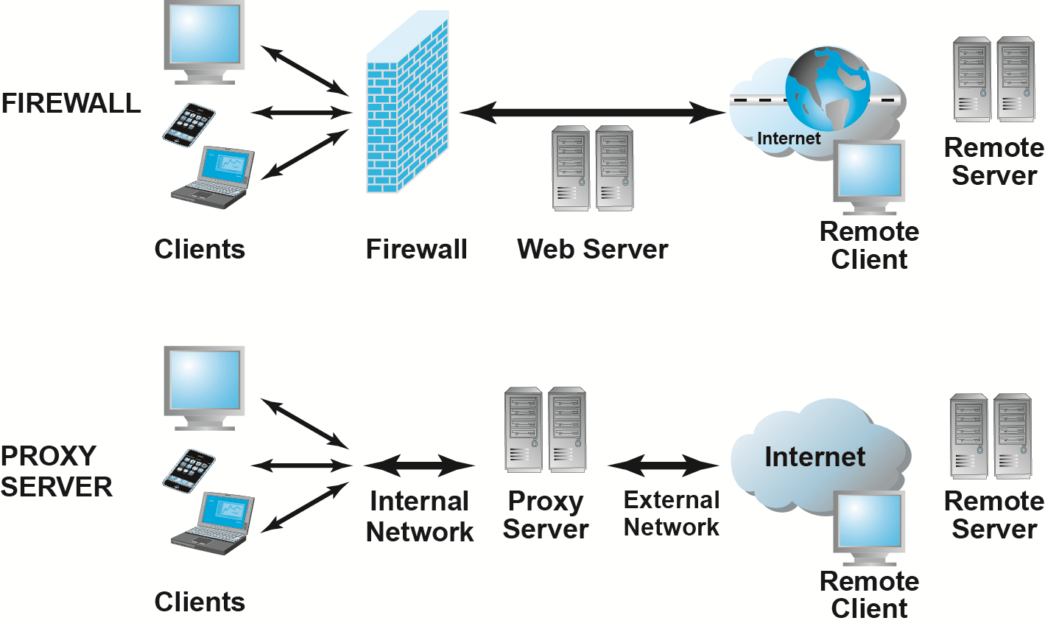
Firewalls and Proxy Servers
Figure 5.11, Page 289
Copyright © 2014 Pearson Education, Inc. Publishing as Prentice Hall
Slide 5-<number>

Slide 26
Protecting Servers and Clients
Operating system security enhancements
  Upgrades, patches
Anti-virus software
  Easiest and least expensive way to prevent threats to system integrity
  Requires daily updates
Copyright © 2014 Pearson Education, Inc. Publishing as Prentice Hall
Slide 5-<number>

Slide 27
Management Policies, Business Procedures, and Public Laws
Worldwide, companies spend more than $65 billion on security hardware, software, services
Managing risk includes:
  Technology
  Effective management policies
  Public laws and active enforcement
Copyright © 2014 Pearson Education, Inc. Publishing as Prentice Hall
Slide 5-<number>

Slide 28
A Security Plan: Management Policies
Risk assessment
Security policy
Implementation plan
  Security organization
  Access controls
  Authentication procedures, including biometrics
  Authorization policies, authorization management systems
Security audit
Copyright © 2014 Pearson Education, Inc. Publishing as Prentice Hall
Slide 5-<number>

Slide 29
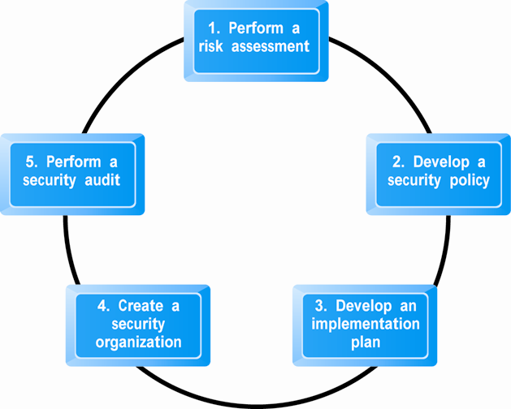
Developing an E-commerce Security Plan
Figure 5.12, Page 291
Copyright © 2014 Pearson Education, Inc. Publishing as Prentice Hall
Slide 5-<number>

Slide 30
Types of Payment Systems
Cash
  Most common form of payment
  Instantly convertible into other forms of value
  No float
Checking transfer
  Second most common payment form in United States
Credit card
  Credit card associations
  Issuing banks
  Processing centers
Copyright © 2014 Pearson Education, Inc. Publishing as Prentice Hall
Slide 5-<number>

Slide 31
Types of Payment Systems (cont.)
Stored value
  Funds deposited into account, from which funds are paid out or withdrawn as needed
  Debit cards, gift certificates
  Peer-to-peer payment systems
Accumulating balance
  Accounts that accumulate expenditures and to which consumers make period payments
  Utility, phone, American Express accounts
Copyright © 2014 Pearson Education, Inc. Publishing as Prentice Hall
Slide 5-<number>
Notes:
Accounts that accumulate expenditures and to which consumers make periodic pay-
ments are accumulating balance payment systems. Traditional examples include
utility, phone, and American Express accounts, all of which accumulate balances,
usually over a specified period (typically a month), and then are paid in full at the
end of the period.

Slide 32
Payment System Stakeholders
Consumers
  Low-risk, low-cost, convenience, reliability
Merchants
  Low-risk, low-cost, secure, reliable
Financial intermediaries
  Secure, low-risk, maximizing profit
Government regulators
  Security, trust, protecting participants and enforcing reporting
Copyright © 2014 Pearson Education, Inc. Publishing as Prentice Hall
Slide 5-<number>

Slide 33
E-commerce Payment Systems
Credit cards
  42% of online payments in 2013 (United States)
Debit cards
  29% online payments in 2013 (United States)
Limitations of online credit card payment
  Security, merchant risk
  Cost
  Social equity
Copyright © 2014 Pearson Education, Inc. Publishing as Prentice Hall
Slide 5-<number>

Slide 34
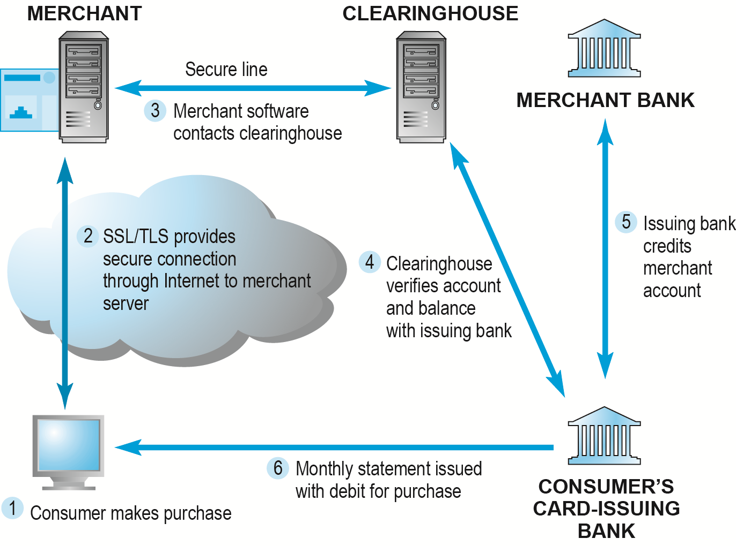
How an Online Credit Transaction Works
Figure 5.15, Page 302
Copyright © 2014 Pearson Education, Inc. Publishing as Prentice Hall
Slide 5-<number>

Slide 35
Alternative Online Payment Systems
Online stored value systems:
  Based on value stored in a consumer’s bank, checking, or credit card account
  Example: PayPal
Other alternatives:
  Amazon Payments
  Google Checkout
  Bill Me Later
  WUPay, Dwolla, Stripe
Copyright © 2014 Pearson Education, Inc. Publishing as Prentice Hall
Slide 5-<number>

Slide 36
Mobile Payment Systems
Use of mobile phones as payment devices established in Europe, Japan, South Korea
Near field communication (NFC)
  Short-range (2”) wireless for sharing data between devices
Expanding in United States
  Google Wallet
    Mobile app designed to work with NFC chips
  PayPal
  Square
Copyright © 2014 Pearson Education, Inc. Publishing as Prentice Hall
Slide 5-<number>
Notes:
Near field communication (NFC) is one of the enabling technologies for mobile payment systems. Near field communication (NFC) is a set of short-range wireless technologies used to share information among devices within about 2 inches of each other (50 mm). NFC devices are either powered or passive. A connection requires one powered unit (the initiator), and one target unpowered unit that can respond to requests from the powered unit. NFC targets can be very simple forms such as tags, stickers, key fobs, or readers. NFC peer-to-peer communication is possible where both devices are powered. An NFC-equipped smartphone, for instance, can be swiped by a merchant’s reader to record a payment wirelessly and without contact.

Slide 37
Digital Cash and Virtual Currencies
Digital cash
  Based on algorithm that generates unique tokens that can be used in “real” world
  Example: Bitcoin
Virtual currencies
  Circulate within internal virtual world
  Example: Linden Dollars in Second Life, Facebook Credits
Copyright © 2014 Pearson Education, Inc. Publishing as Prentice Hall
Slide 5-<number>

Slide 38
Bitcoin
What are some of the benefits of using a digital currency?
What are the risks involved to the user?
What are the political and economic repercussions of a digital currency?
Have you or anyone you know ever used Bitcoin?
Copyright © 2014 Pearson Education, Inc. Publishing as Prentice Hall
Slide 5-<number>

Slide 39
Copyright © 2014 Pearson Education, Inc. Publishing as Prentice Hall
Slide 5-<number>

